Slide 1

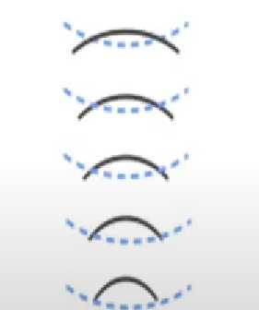


SONAR
Rock VS Mine Prediction
With python

Slide 3


Slide 4


Slide 5


Slide 6
